Slide 1
01 Intro to RL

Slide 2

This tutorial is mainly contributed by…
Github
方泽鸣，zemingfang11@gmail.com
张洳源，ruyuanzhang@gmail.com
张洁莹，jieying.zhang@student.uva.nl
部分内容由张洳源老师正在编写的教材《认知行为的计算原理》收录： https://ruyuanzhang.gitbook.io/compmodcogpsy

Slide 3

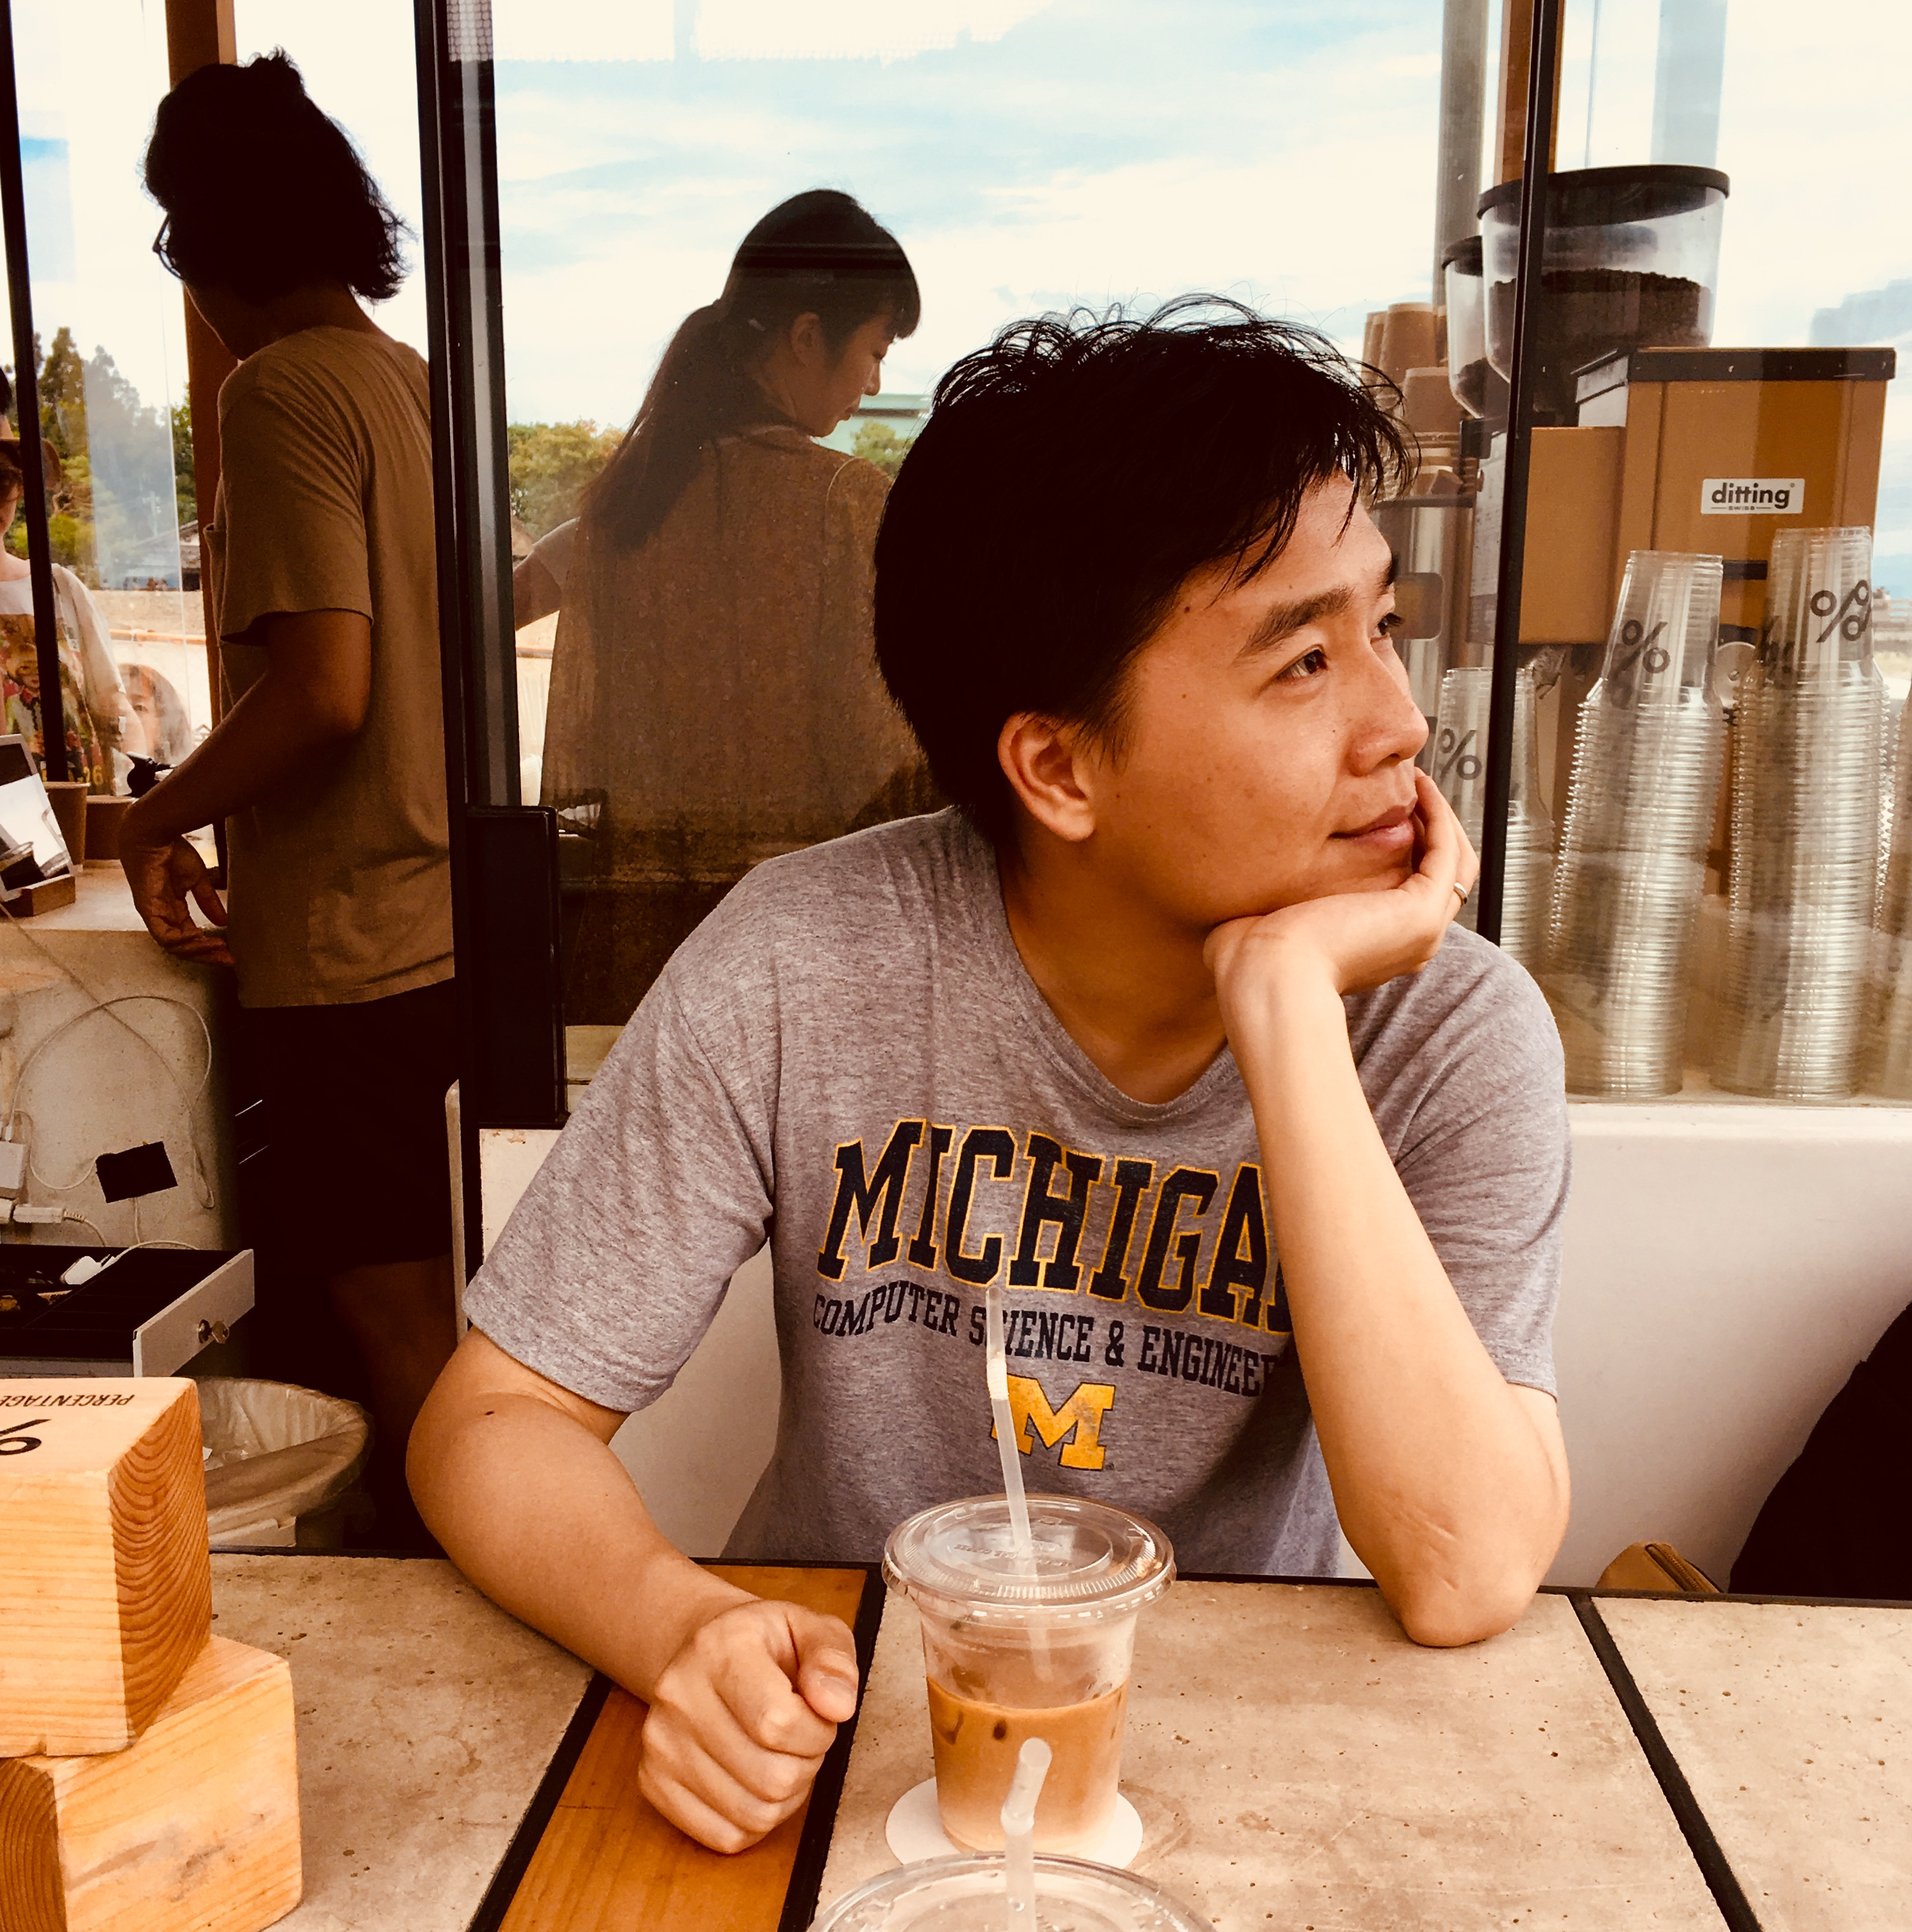
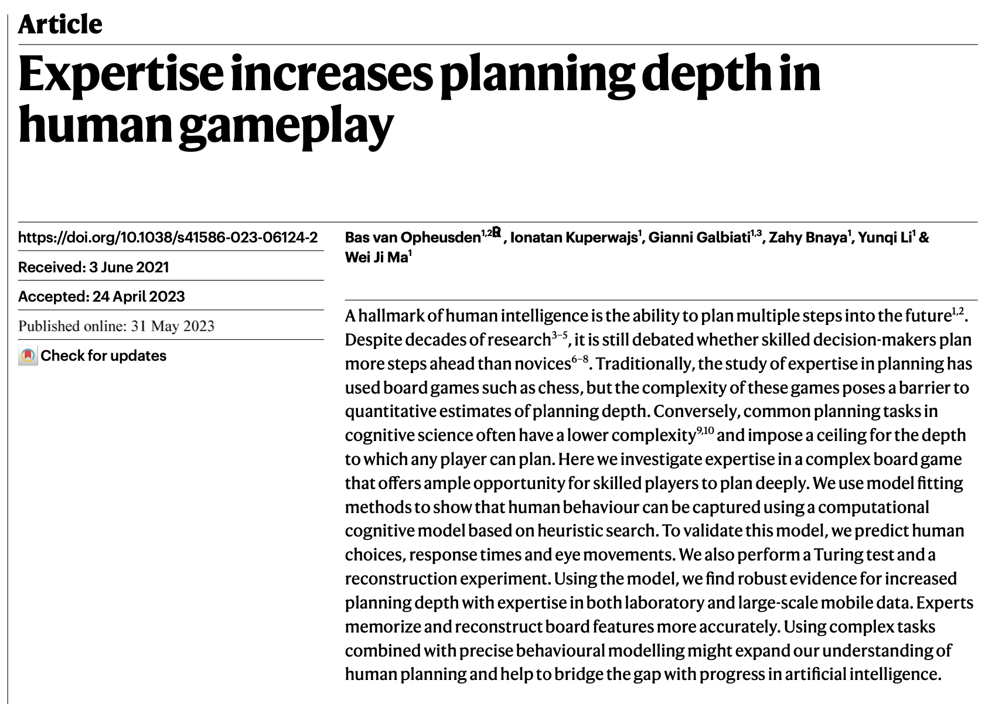
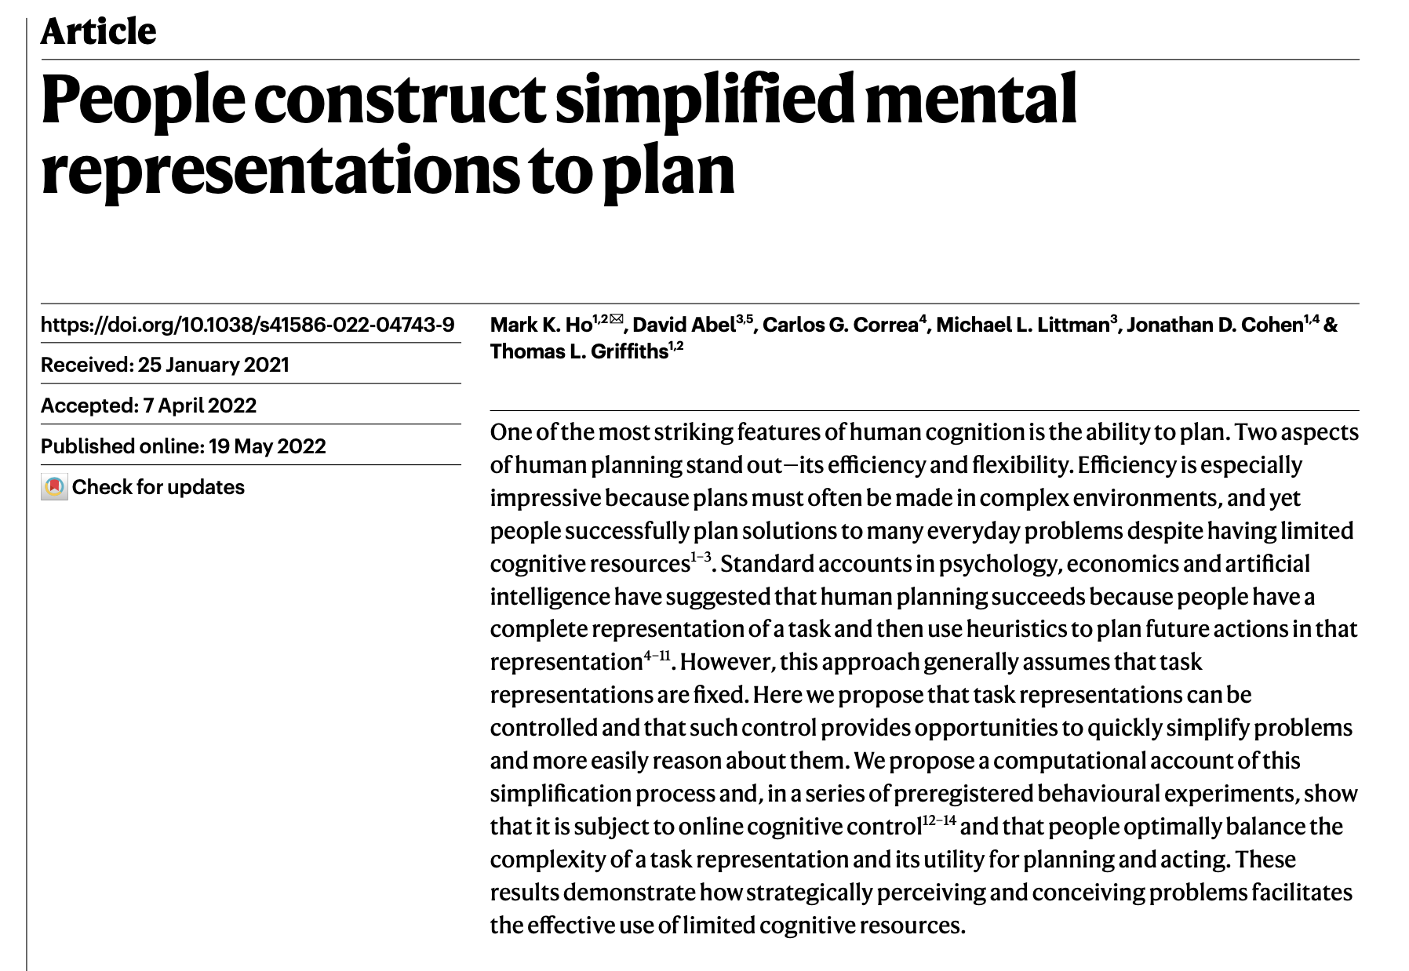




The motivation of this tutorial
CS285: Deep Reinforcement Learning
CS542: Statistical Reinforcement Learning
Shuhuai008: 强化学习
UCL course on RL: Reinforcement Learning
RL theory
Hugging face
Math & CS background
MindRL hub workshop
RW model in psychology & Neuroscience
Hands-on-practice
Progmmaing & computational resources
Q learning in psychology
Notes:
与蒙特卡洛树搜索相关（第五节）

Slide 4
What we might learn?
Understand that reinforcement learning extends beyond the Rescorla-Wagner model
Implement a classical reinforcement learning algorithms from scratch
Learn how to frame psychological problems within the reinforcement learning framework
Gain acquiantance with some cutting-edge content about planning

Slide 5
Overview
Lecture
Markov Decision Process (MDP)
State, action, reward, transition
Decision-making on MDP
Goal, value, poilcy, Q value
Value evaluation
Bellman equation
Policy evaluation
Practice Policy evaluaton

Slide 6
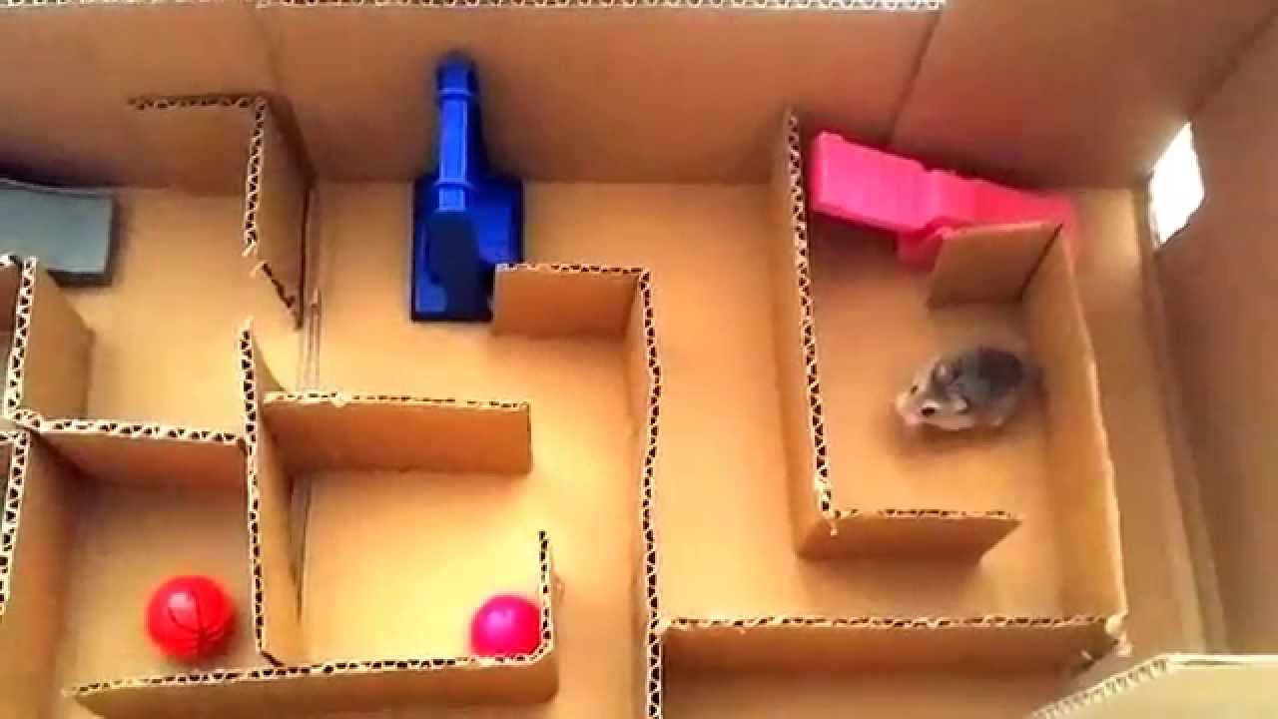

Slide 7
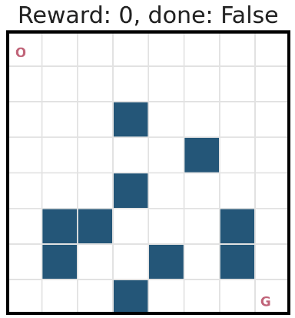
Frozen Lake
Reference:
https://github.com/udacity/deep-reinforcement-learning/blob/master/dynamic-programming/frozenlake.py
20% slippery rate

Slide 8
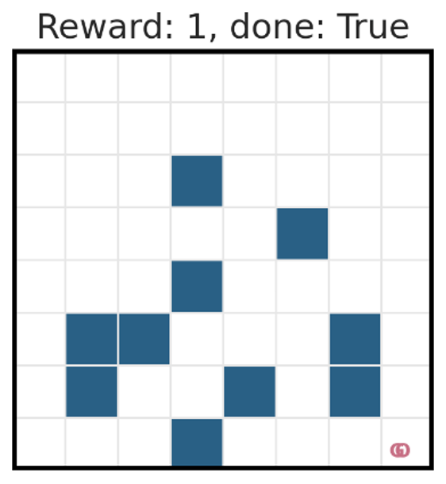
Frozen Lake
Reference:
https://github.com/udacity/deep-reinforcement-learning/blob/master/dynamic-programming/frozenlake.py

Slide 9
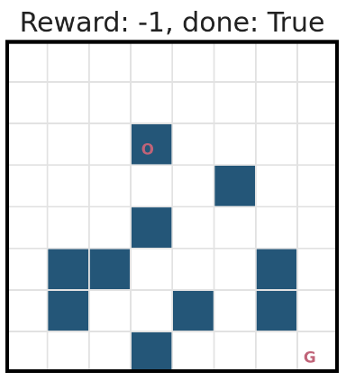
Frozen Lake
Reference:
https://github.com/udacity/deep-reinforcement-learning/blob/master/dynamic-programming/frozenlake.py

Slide 10
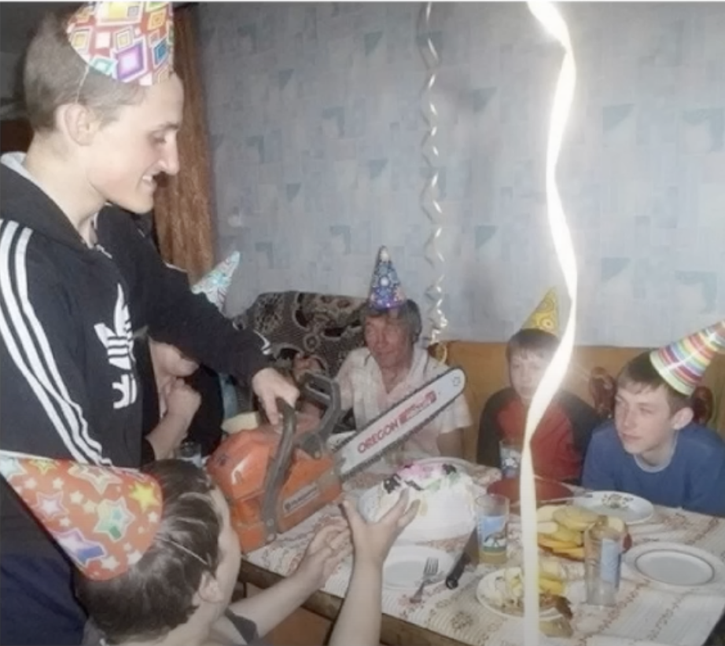
(McElearth 2023)

Slide 11
Markov Decision Process (MDP)

Slide 12
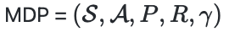
Markov decision process (MDP)
S_{t-1}
S_{t}
S_{t+1}
R_{t-1}
R_{t}
R_{t+1}
A_{t-1}
A_{t}
A_{t+1}

Slide 13
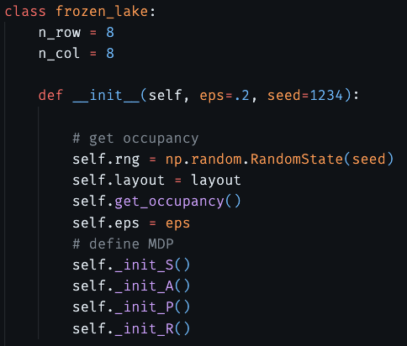
Markov decision process (MDP)

Slide 14
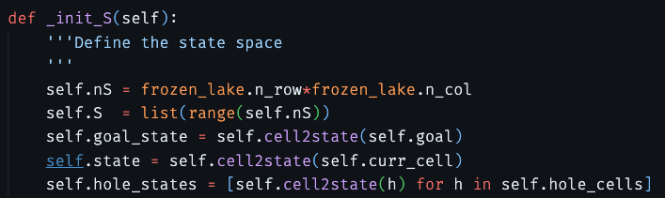
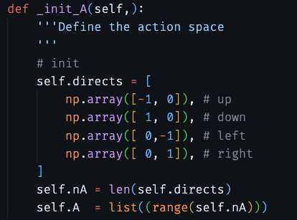
Markov decision process (MDP)

Slide 15
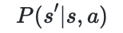
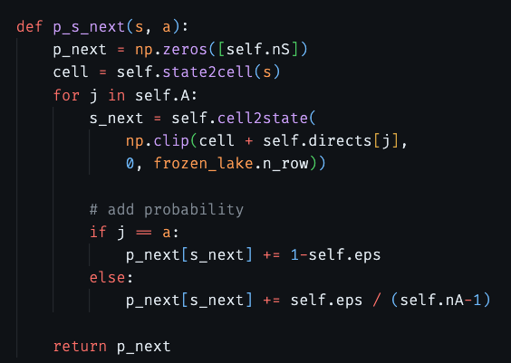
Markov decision process (MDP)

Slide 16
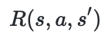
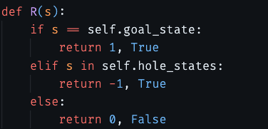
Markov decision process (MDP)

Slide 17
Markov decision process (MDP)
S_{t-1}
S_{t}
S_{t+1}
Why Markov property?
R_{t-1}
R_{t}
R_{t+1}
A_{t-1}
A_{t}
A_{t+1}

Slide 18
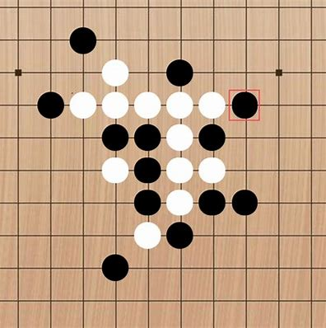
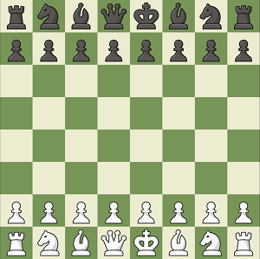

Markov decision process (MDP)

Slide 19
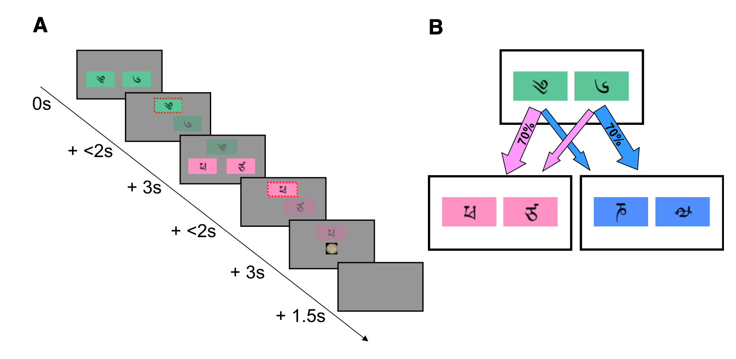
Markov decision process (MDP)
￥9
￥1
￥6
￥4
state: 当前的字
action: 选去哪一个state的action
reward: 最后拿到的钱
(Daw, 2011, Neuron)

Slide 20
Decision-making on MDP

Slide 21
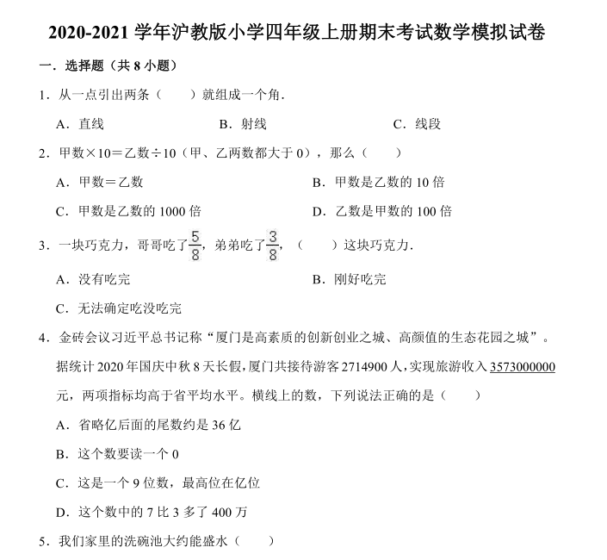
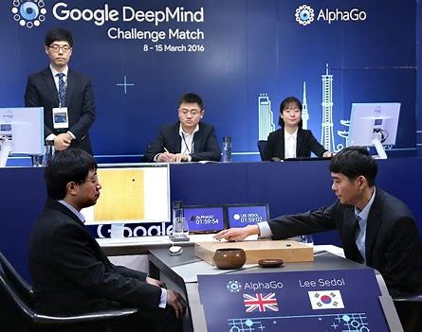
Goal

Slide 22
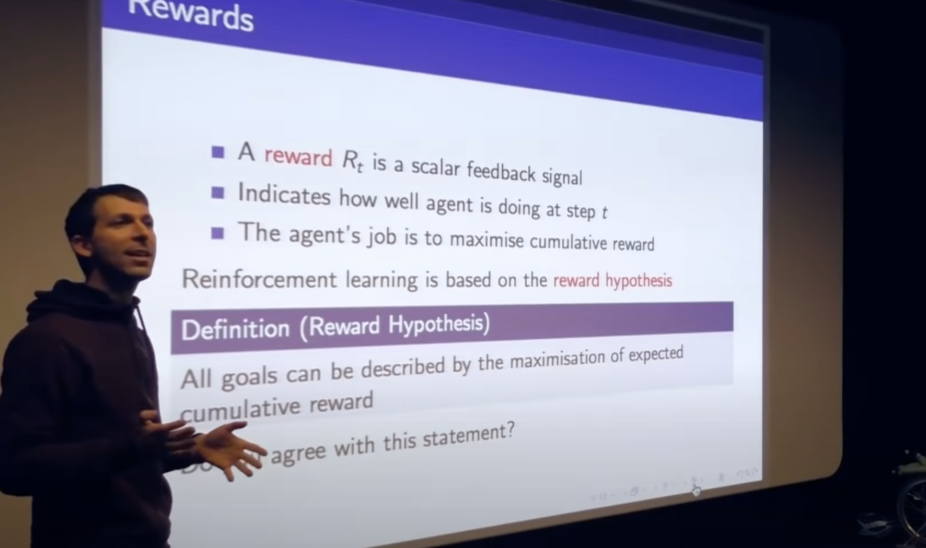
Goal: reward hypothesis
(Silver, 2022, Artificial Intelligence)

Slide 23
Reward

Slide 24
Cumulative reward
S_{t-1}
S_{t}
S_{t+1}
R_{t-1}
R_{t}
R_{t+1}
A_{t-1}
A_{t}
A_{t+1}

Slide 25
Expected cumulative reward
S_{t-1}
S_{t}
S_{t+1}
R_{t-1}
R_{t}
R_{t+1}
A_{t-1}
A_{t}
A_{t+1}

Slide 26
Value: expected cumulative reward at a given state
S_{t}
S_{t+1}
S_{t-1}=s
R_{t-1}
R_{t}
R_{t+1}
A_{t-1}
A_{t}
A_{t+1}

Slide 27
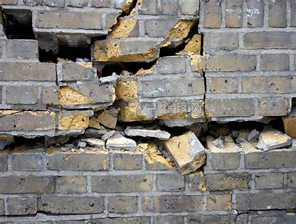
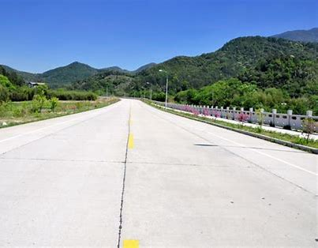
Value: expected cumulative reward at a given state
君子不立危墙之下

Slide 28
Policy
S_{t}
S_{t+1}
S_{t-1}=s
R_{t-1}
R_{t}
R_{t+1}
A_{t-1}
A_{t}
A_{t+1}
A policy maps a state to a distribution of actions

Slide 29
Goal: reward hypothesis

Slide 30
Q Value: expected cumulative reward at a given state and a given action
S_{t}
S_{t+1}
S_{t-1}=s
R_{t-1}
R_{t}
R_{t+1}
A_{t}
A_{t+1}
A_{t-1}=a

Slide 31
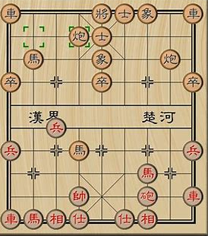
Value evaluation is not easy
要不要读博？
o

Slide 32
Bellman equation
S_{t}=s

Slide 33

Bellman equation
S_{t}=s
A_{t}
o

Slide 34
Bellman equation
S_{t}=s
S_{t+1}
R_{t}
A_{t}

Slide 35
Bellman equation
S_{t}=s
S_{t+1}
R_{t}
A_{t}

Slide 36
Bellman equation
Correct value evaluation should stasitfy this Bellman equation:
This also applies to the state-action value function (Q function)

Slide 37
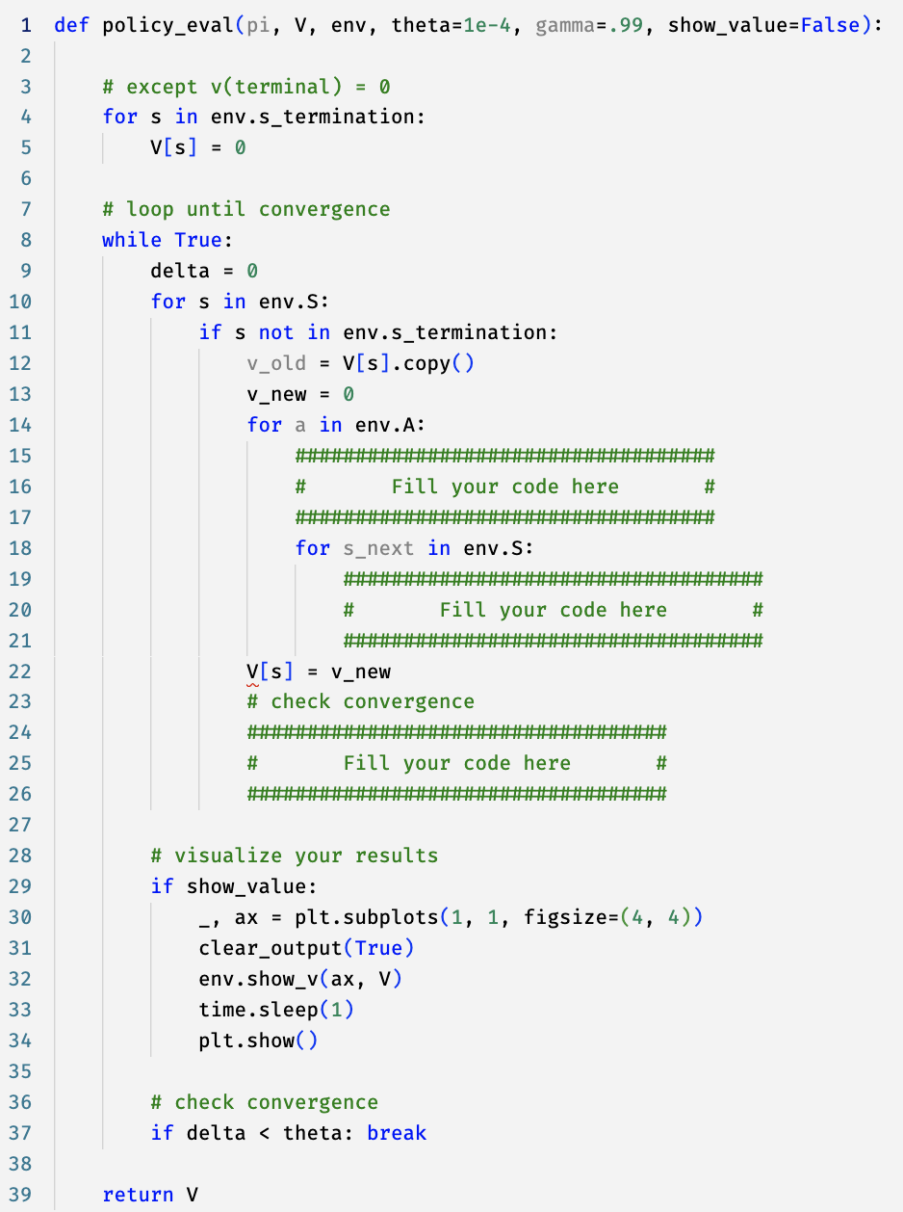
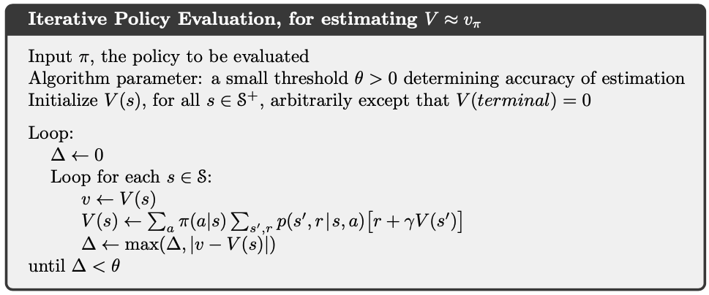

Dynamic programming: poicy evaluation

Slide 38
Summary
Lecture
Markov Decision Process (MDP)
State, action, reward, transition
Decision making on MDP
Goal, value, Q value, poilcy
Value evaluation
Bellman equation
Policy evaluation
Practice Policy evaluaton
Take-home Practice
Frame the two-stage task as a MDP
Derive the Bellman equation for Q-values

Slide 39
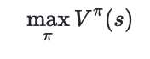
Reward hypothesis

Slide 40
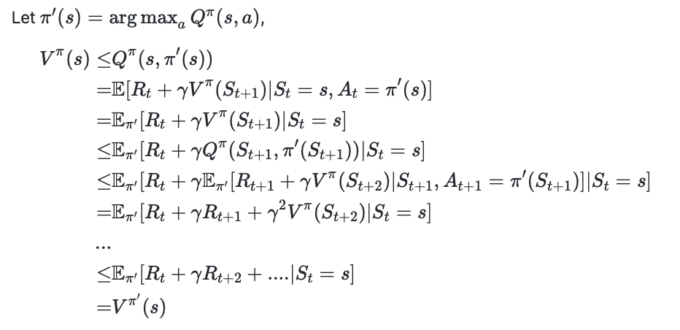
Policy improvement

Slide 41
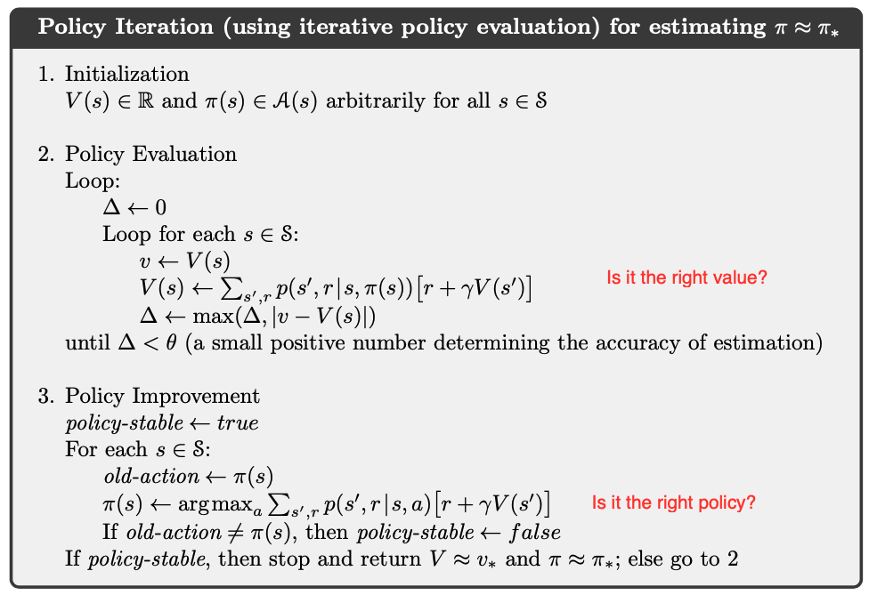
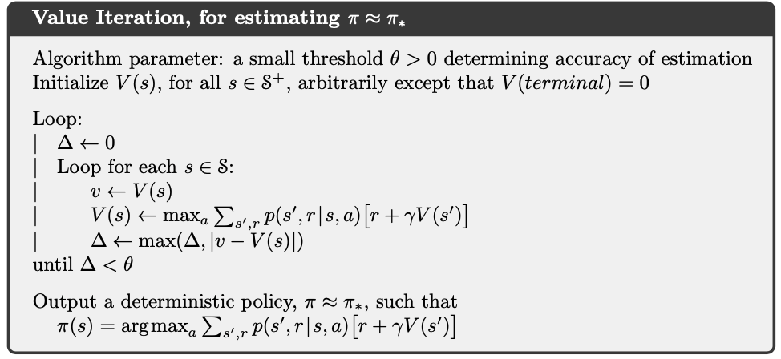
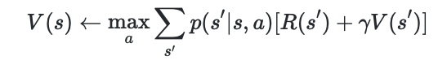
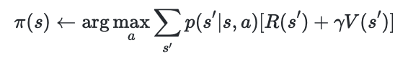
Policy improvement

